Slide 1

Glassdoor's Data Jobs - Salary Prediction
Kyle Kuberski | Banu Pullaiahnaidu | Mai Dang
September 2023

Slide 2





Introduction
Dataset Description
EDA
Objective 1
Objective 2
Conclusion
Dataset and data processing summary
Assumptions! Assumptions! Assumptions!
Highly interpretable models
Comparison of multiple models for the best prediction
Summary and Improvements

Slide 3
Introduction
Dataset Description
EDA
Objective 1
Objective 2
Conclusion
Dataset and data processing summary
Assumptions! Assumptions! Assumptions!
Highly interpretable models
Comparison of multiple models for the best prediction
Summary and Improvements

Slide 4
Introduction
Dataset Description
EDA
Objective 1
Objective 2
Conclusion
Dataset and data processing summary
Assumptions! Assumptions! Assumptions!
Highly interpretable models
Comparison of multiple models for the best prediction
Summary and Improvements

Slide 5
Introduction
Dataset Description
EDA
Objective 1
Objective 2
Conclusion
Dataset and data processing summary
Assumptions! Assumptions! Assumptions!
Highly interpretable models
Comparison of multiple models for the best prediction
Summary and Improvements

Slide 6
Introduction
Dataset Description
EDA
Objective 1
Objective 2
Conclusion
Dataset and data processing summary
Assumptions! Assumptions! Assumptions!
Highly interpretable models
Comparison of multiple models for the best prediction
Summary and Improvements

Slide 7
Dataset
Source
Summary
Kaggle
742 job postings scraped from Glassdoor
42 variables
Response Variable
Numerical Variables (2)
Average Salary
Rating – Company rating
Age – Company_ history
Categorial variables (39)
Job_title , Job.Location ,
Degree , Sector
etc.

Slide 8
Dataset
Source
Summary
Kaggle
742 job postings scraped from Glassdoor
42 variables
Response Variable
Numerical Variables (2)
Average Salary
Rating – Company rating
Age – Company_ history
Categorial variables (39)
Job_title , Job.Location ,
Degree , Sector
etc.

Slide 9
Dataset
Source
Summary
Kaggle
742 job postings scraped from Glassdoor
42 variables
Response Variable
Numerical Variables (2)
Average Salary
Rating – Company rating
Age – Company_ history
Categorial variables (39)
Job_title , Job.Location ,
Degree , Sector
etc.

Slide 10
Dataset
Source
Summary
Kaggle
742 job postings scraped from Glassdoor
42 variables
Response Variable
Numerical Variables (2)
Average Salary
Rating – Company rating
Age – Company_ history
Categorial variables (39)
Job_title , Job.Location ,
Degree , Sector
etc.

Slide 11
Dataset
Source
Summary
Kaggle
742 job postings scraped from Glassdoor
42 variables
Response Variable
Numerical Variables (2)
Average Salary
Rating – Company rating
Age – Company_ history
Categorial variables (39)
Job_title , Job.Location ,
Degree , Sector
etc.

Slide 12
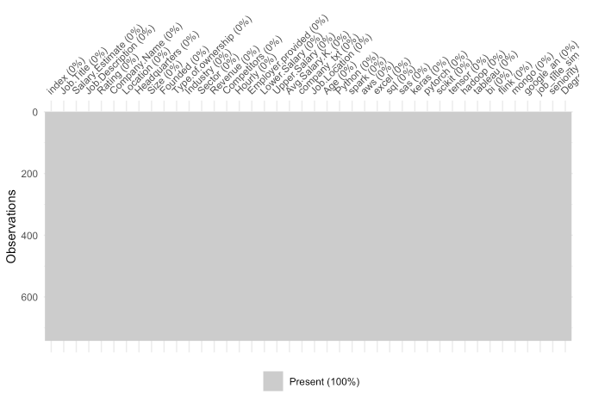
Missing values?

Slide 13
Missing values
Sectors
Revenue
10​
204
Job_Titles
10
Rating
Size
11
10​

Slide 14
Missing values
Sectors
Revenue
10​
204
Job_Titles
10
Rating
Size
11
10​

Slide 15
Missing values
Sectors
Revenue
10​
204
Job_Titles
10
Rating
Size
11
10​

Slide 16
Missing values
Sectors
Revenue
10​
204
Job_Titles
10
Rating
Size
11
10​

Slide 17
Missing values
Sectors
Revenue
10​
204
Job_Titles
10
Rating
Size
11
10​

Slide 18
Missing values
Experience
519​
Company_history
Degree
50​
383

Slide 19
Missing values
Experience
519​
Company_history
Degree
50​
383

Slide 20
Missing values
Experience
519​
Company_history
Degree
50​
383

Slide 21
Data Processing
Remove outlier (1)
A full-time data scientist job in NYPD with 6 years experienced and master degree preferably with the average salary is 15.5K
Remove redundant variables (14)
Index, Job title (full), Job Descriptions, Company Name, Company text
Estimated Salary, Lower & Upper Salary, Founded
Location, Headquarter, Competitors, Employers
Predictors remain (27)
Company_history, Size, Revenue, Sector, Ownership_type, Rating
Job_title, Job.Location, Hourly
Experience, Degree
Keras, pytorch, skicit, tensor, hadoop, spark, bi, tableau, flink, mongo, sql, Python, excel, aws, sas, google_an

Slide 22
Data Processing
Remove outlier (1)
A full-time data scientist job in NYPD with 6 years experienced and master degree preferably with the average salary is 15.5K
Remove redundant variables (14)
Index, Job title (full), Job Descriptions, Company Name, Company text
Estimated Salary, Lower & Upper Salary, Founded
Location, Headquarter, Competitors, Employers
Predictors remain (27)
Company_history, Size, Revenue, Sector, Ownership_type, Rating
Job_title, Job.Location, Hourly
Experience, Degree
Keras, pytorch, skicit, tensor, hadoop, spark, bi, tableau, flink, mongo, sql, Python, excel, aws, sas, google_an

Slide 23
Data Processing
Remove outlier (1)
A full-time data scientist job in NYPD with 6 years experienced and master degree preferably with the average salary is 15.5K
Remove redundant variables (14)
Index, Job title (full), Job Descriptions, Company Name, Company text
Estimated Salary, Lower & Upper Salary, Founded
Location, Headquarter, Competitors, Employers
Predictors remain (27)
Company_history, Size, Revenue, Sector, Ownership_type, Rating
Job_title, Job.Location, Hourly
Experience, Degree
Keras, pytorch, skicit, tensor, hadoop, spark, bi, tableau, flink, mongo, sql, Python, excel, aws, sas, google_an

Slide 24
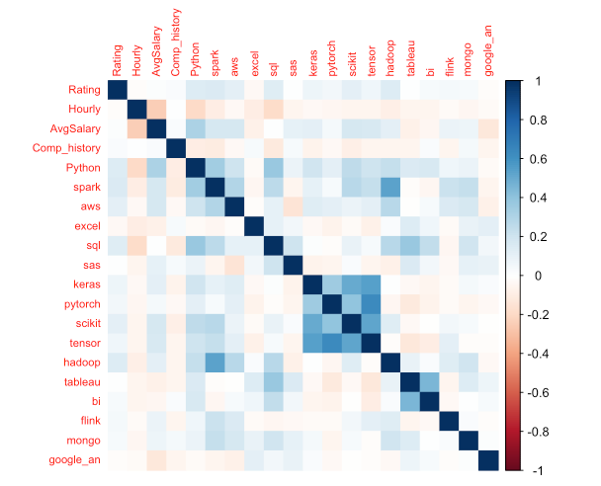
New predictors

Slide 25
New predictors

Slide 26
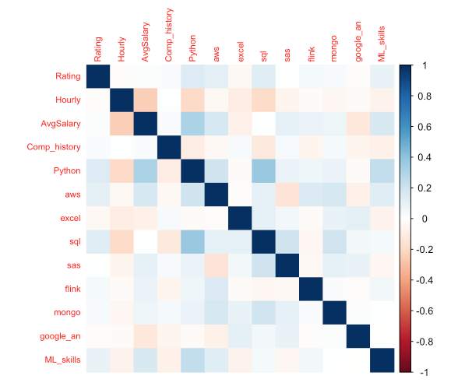
New predictors

Slide 27
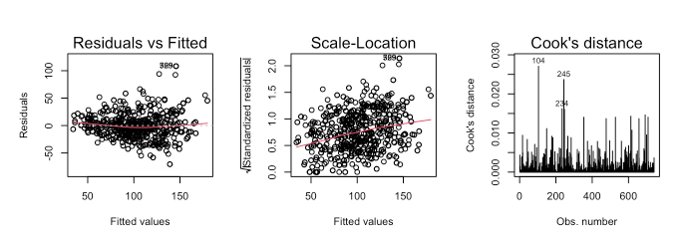
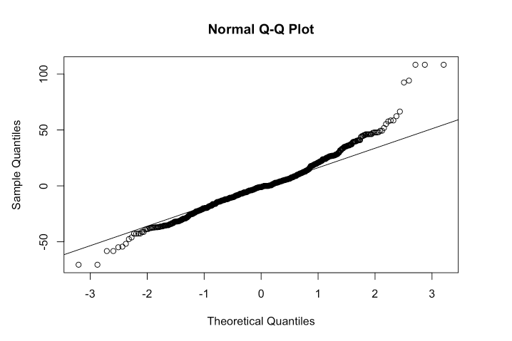
Assumptions(Original Salary)

Slide 28
Assumptions(Original Salary)

Slide 29
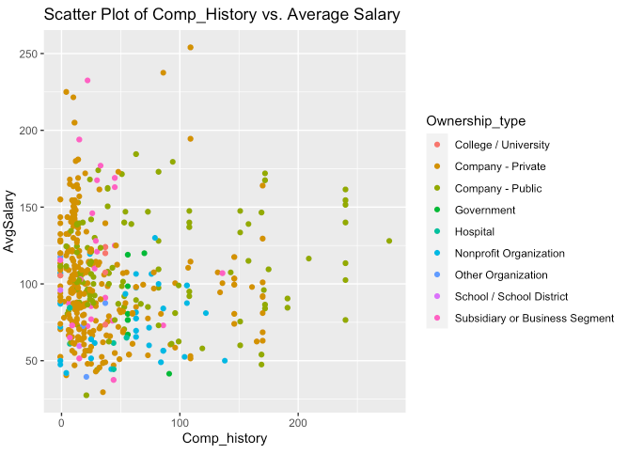
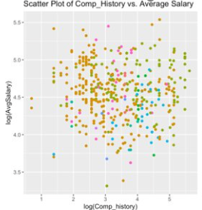
Log transformation

Slide 30
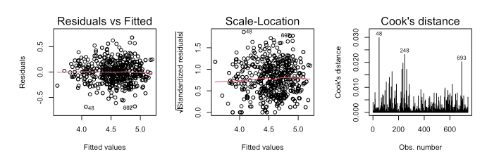
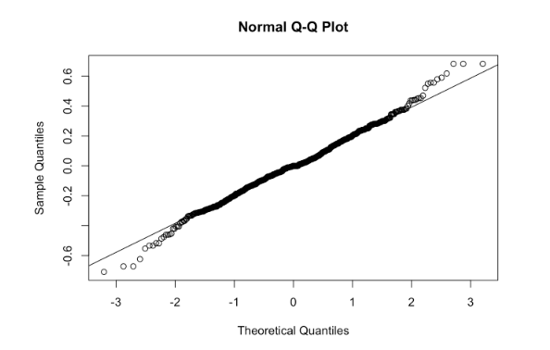
Assumptions(Log Salary)

Slide 31
Assumptions(Log Salary)

Slide 32
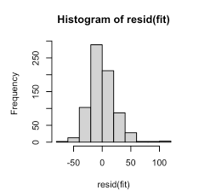
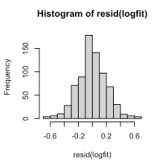
Normality assumptions

Slide 33


Questions of Interest
QOI 1
Which predictors are practically or statistically significant? Or insignificant?
QOI 2​
Which skill set will be associated with the highest increase in the average salary?
QOI 3
Which job title or location will have the most increase/decrease in the average salary compared to the reference?

Slide 34
Questions of Interest
QOI 1
Which predictors are practically or statistically significant? Or insignificant?
QOI 2​
Which skill set will be associated with the highest increase in the average salary?
QOI 3
Which job title or location will have the most increase/decrease in the average salary compared to the reference?

Slide 35
Questions of Interest
QOI 1
Which predictors are practically or statistically significant? Or insignificant?
QOI 2​
Which skill set will be associated with the highest increase in the average salary?
QOI 3
Which job title or location will have the most increase/decrease in the average salary compared to the reference?

Slide 36
Objective 1
Model fitting approach
Summary of p-value, confidence intervals and VIFs
Regression coefficient interpretation
Feature Selection, variables included/excluded how/why
The Final Model
Presentation Title

Slide 37
Objective 1
Model fitting approach
Summary of p-value, confidence intervals and VIFs
Regression coefficient interpretation
Feature Selection, variables included/excluded how/why
The Final Model
Presentation Title

Slide 38
Objective 1
Model fitting approach
Summary of p-value, confidence intervals and VIFs
Regression coefficient interpretation
Feature Selection, variables included/excluded how/why
The Final Model
Presentation Title

Slide 39
Objective 1
Model fitting approach
Summary of p-value, confidence intervals and VIFs
Regression coefficient interpretation
Feature Selection, variables included/excluded how/why
The Final Model
Presentation Title

Slide 40
Objective 1
Model fitting approach
Summary of p-value, confidence intervals and VIFs
Regression coefficient interpretation
Feature Selection, variables included/excluded how/why
The Final Model
Presentation Title

Slide 41
Objective 1
Model fitting approach
Summary of p-value, confidence intervals and VIFs
Regression coefficient interpretation
Feature Selection, variables included/excluded how/why
The Final Model
Presentation Title

Slide 42
We started with log transformed AvgSalary, 22 predictors and 741 observations
Model fitting approach
We fit a MLR with all predictors and looked at the p-values to see if any of the predictors had a p-value that is significant and validated it against the confidence intervals for those predictors
We also looked at the VIFs to see if any of the predictors are highly correlated.
We then ran an automatic variable selection procedure using forward selection method.
Following the above steps, we narrowed on a list of predictors for our final model

Slide 43
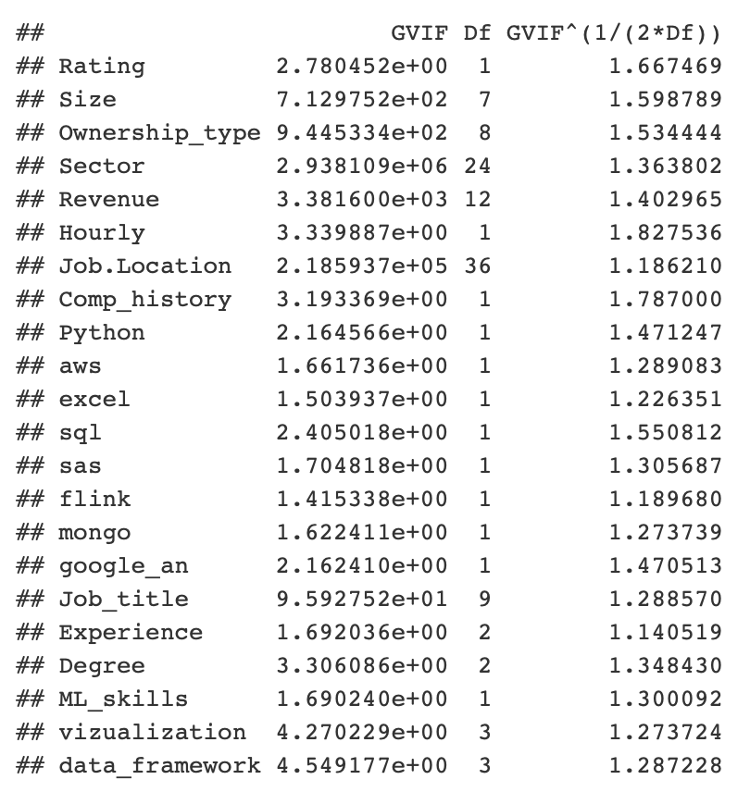
In our case since we have more categorical predictors than continuous, some of the VIFs are very high as expected with categorical predictors with multiple levels
Summary of p-value, confidence intervals and VIFs

Slide 44
In our case since we have more categorical predictors than continuous, some of the VIFs are very high as expected with categorical predictors with multiple levels
Summary of p-value, confidence intervals and VIFs

Slide 45
In our case since we have more categorical predictors than continuous, some of the VIFs are very high as expected with categorical predictors with multiple levels
Summary of p-value, confidence intervals and VIFs
Reviewing the VIFs we see that Sector, Job.Location, Revenue, Size, Ownership_type and Job_title all have very high VIFs

Slide 46
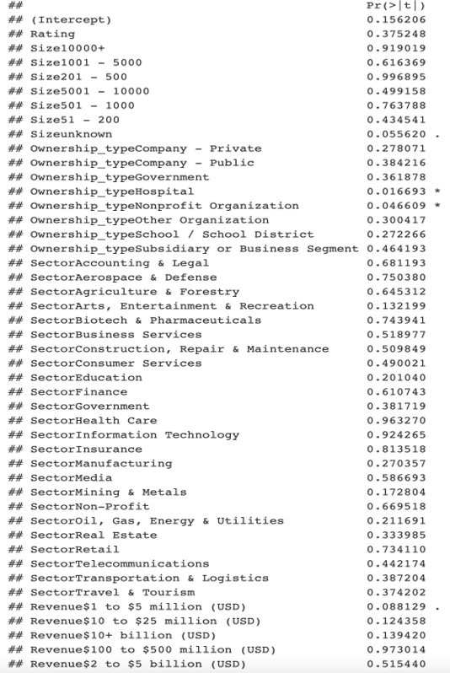
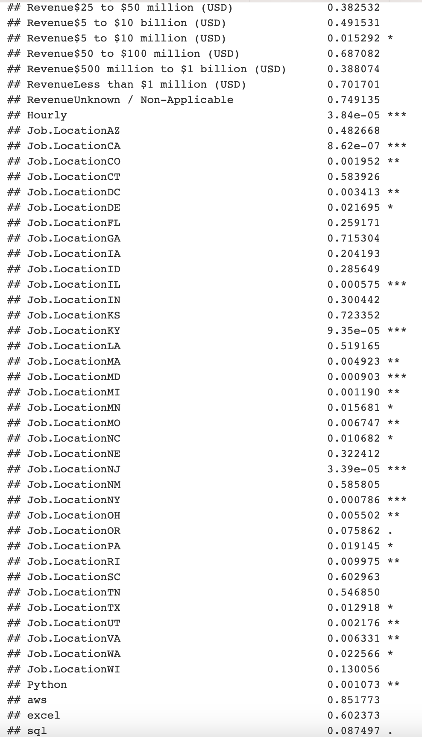
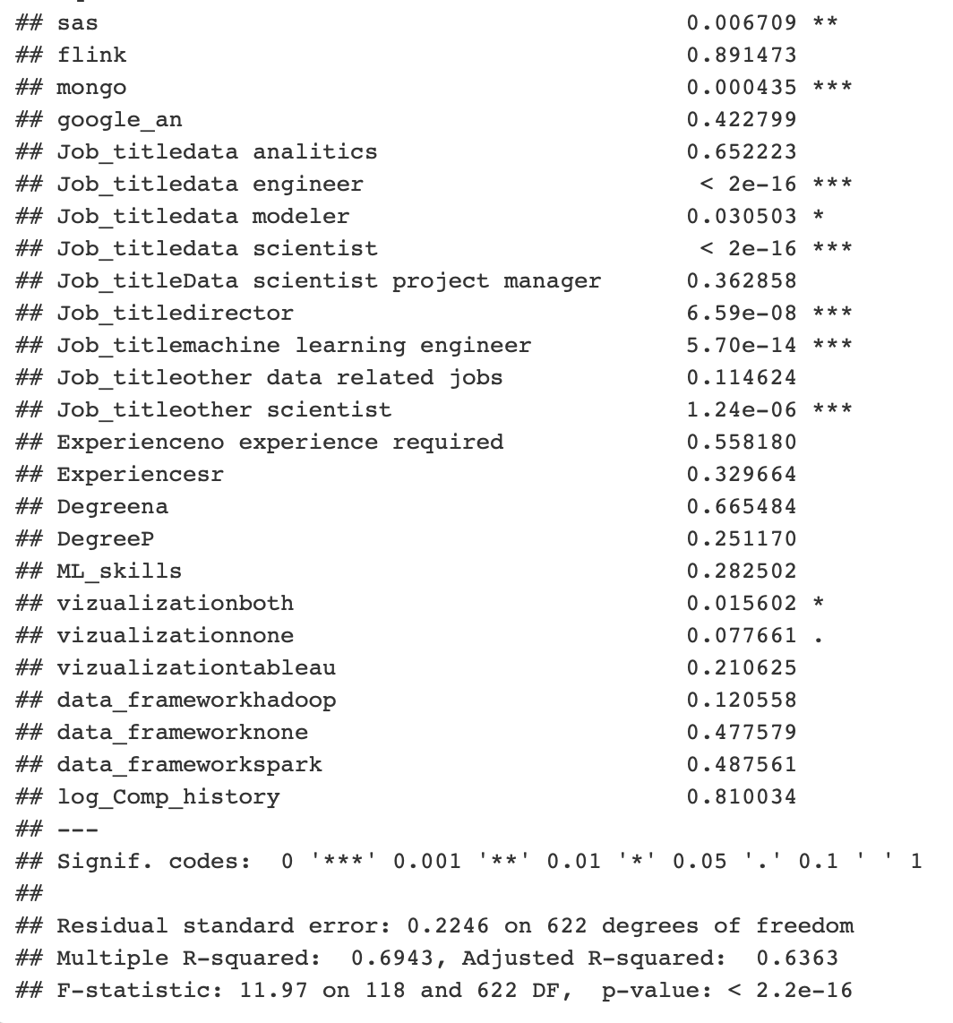
Summary of p-value, confidence intervals and VIFs

Slide 47
Summary of p-value, confidence intervals and VIFs

Slide 48
Summary of p-value, confidence intervals and VIFs

Slide 49
As you can see from the above results, we have a lot of categorical predictors with multiple levels and p-value at (alpha < 0.05) suggests that the following predictors are statistically significant Ownership_type, Revenue, Hourly, Job.Location, Python, sas, mongo, Job_title
Summary of p-value, confidence intervals and VIFs

Slide 50
The reference for the interpretation of the coefficients:
Full-time Job
Job title : analyst
Job Location : Alabama
Organization : College/university
Revenue : unknown
Sector : no specified
Rating : no rating
History/age of the organization : no age
Degree : Masters
Experience : Junior
Visualization : bi
Size : 1-50
Data_framework : both
ML Skills : None
All other skills are none
Regression coefficient interpretation

Slide 51
The reference for the interpretation of the coefficients: a full-time junior analyst job from a college/ university organization in Alabama.
Regression Coefficient for Job Location - there is overwhelming evidence to suggest that some locations are associated with the positive change in the median salary. For example, holding all the other variables constant for someone in California, the median salary would have a 63% increase (p-value. <0.0001). A 95% confidence interval for this increase is from 35%-99% in the median salary.
Regression coefficient interpretation
Similarly, there is evidence that knowing Python is an advantage. Holding all the other variables constant for someone who has knowledge
of Python is associated with 8% increase in the median salary (p-value = 0.001). A 95% confidence interval of this increase is from 3% to 14%.
Also, as we all want to know if getting a master's degree in data science is a good investment. There is strong evidence to suggest that the data scientist job title is associated with the higher pay than an analyst job. Holding all other variables constant, for Job title of Data Scientist estimated median salary (p-value <0.0001) is 52% higher than median salary of an analyst Job title. A 95% confidence interval for this increase is from 41% to 63%.

Slide 52
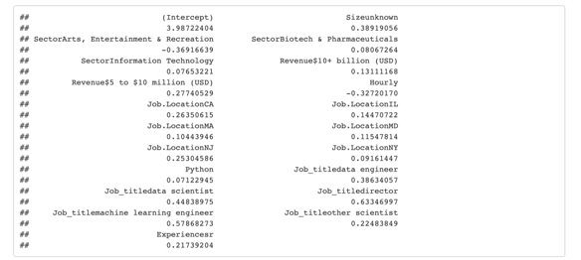
Automatic variable selection using forward selection method
Feature Selection, variables included/excluded how/why
Size, Sector Revenue, Hourly Job.Location, Python Job_title, Experience

Slide 53
Combining the review of MLR, Forward selection and EDA, we chose the following predictors for further analysis and prediction modeling
The Final Model
Job_title
Job.Location
Experience
mongo
Degree
Hourly
Python
sas

Slide 54
Objective 2
Added Complexity
Further EDA
Models
Performance
Prediction
Presentation Title

Slide 55
Objective 2
Added Complexity
Further EDA
Models
Performance
Prediction
Presentation Title

Slide 56
Objective 2
Added Complexity
Further EDA
Models
Performance
Prediction
Presentation Title

Slide 57
Objective 2
Added Complexity
Further EDA
Models
Performance
Prediction
Presentation Title

Slide 58
Objective 2
Added Complexity
Further EDA
Models
Performance
Prediction
Presentation Title

Slide 59
Objective 2
Added Complexity
Further EDA
Models
Performance
Prediction
Presentation Title

Slide 60


Approach to Complexity:
Basic Regression
Allowed for a view into statistically significant predictors
Glmnet + Logged Response
Narrowed model with specified predictors
How can we add complexity?
Interaction between specified predictors

Slide 61
Further Exploration: Interaction Variables
Theoretical Rationale, Practicality, Domain Knowledge
Prior reasoning why certain predictors will interact meaningfully
Considerations of practical significance
Subject matter expertise; what makes sense based on what we know

Slide 62
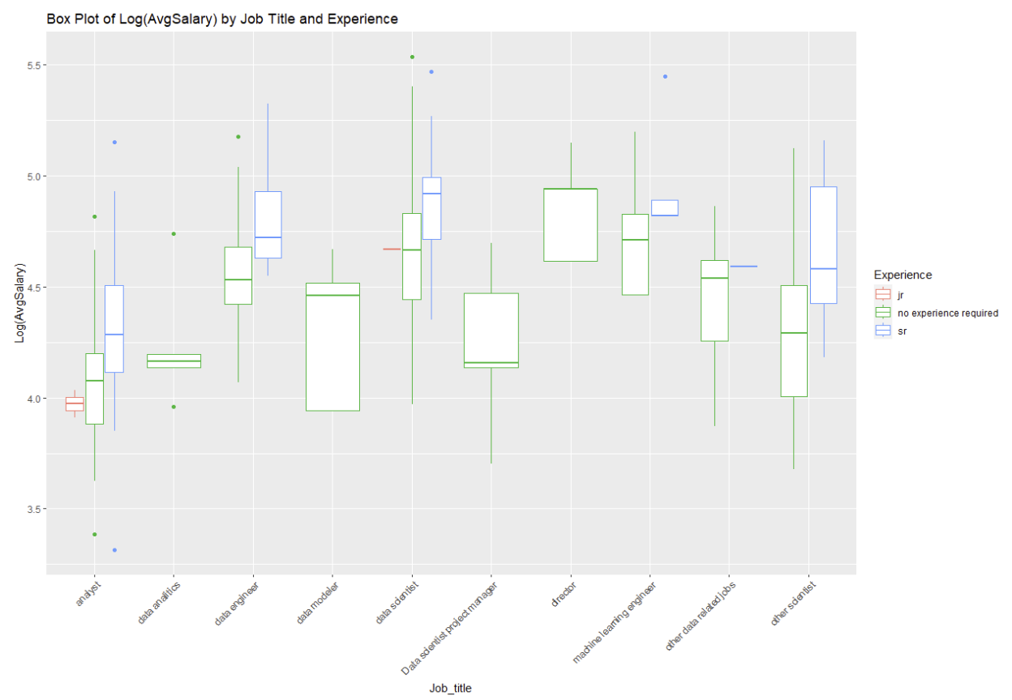
Further EDA Job Title & Experience

Slide 63
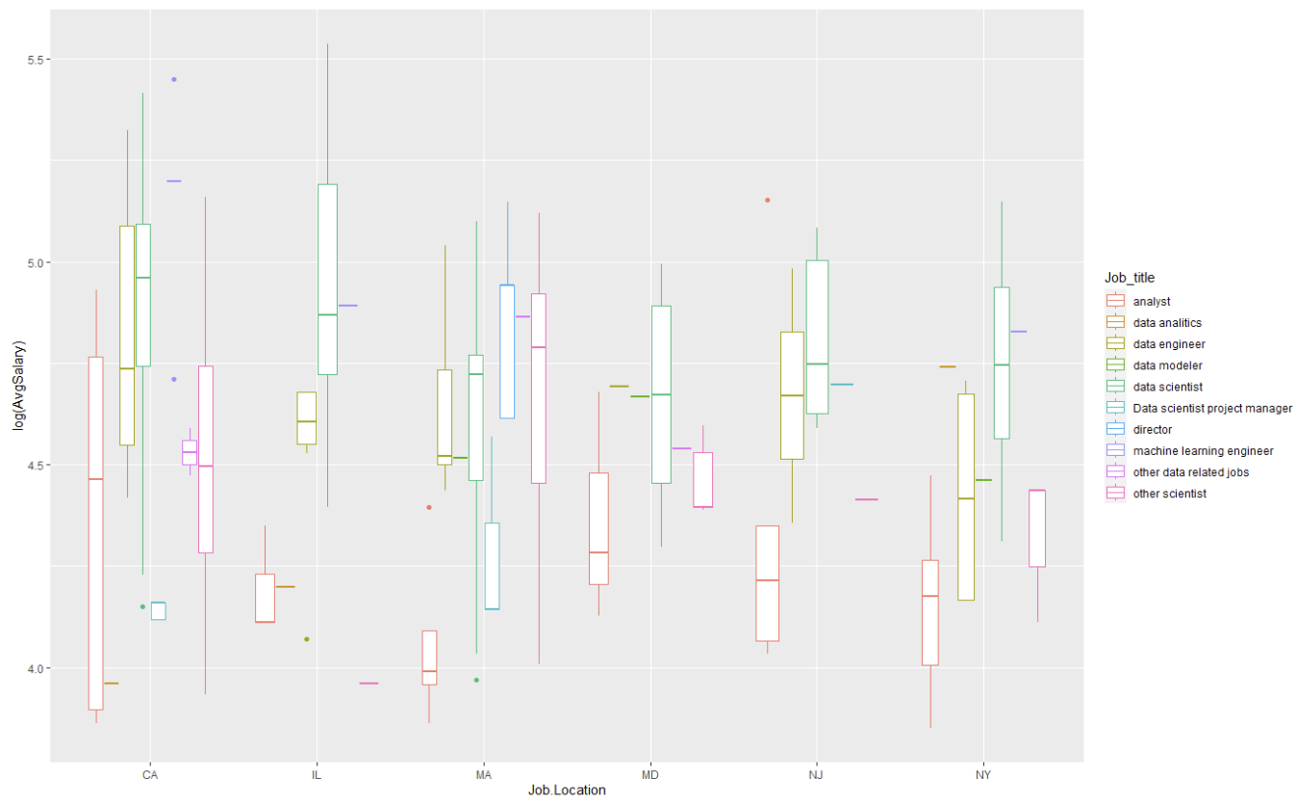
Further EDA Job Title & Location
Notes:
Redo slide with new graph on just important states

Slide 64
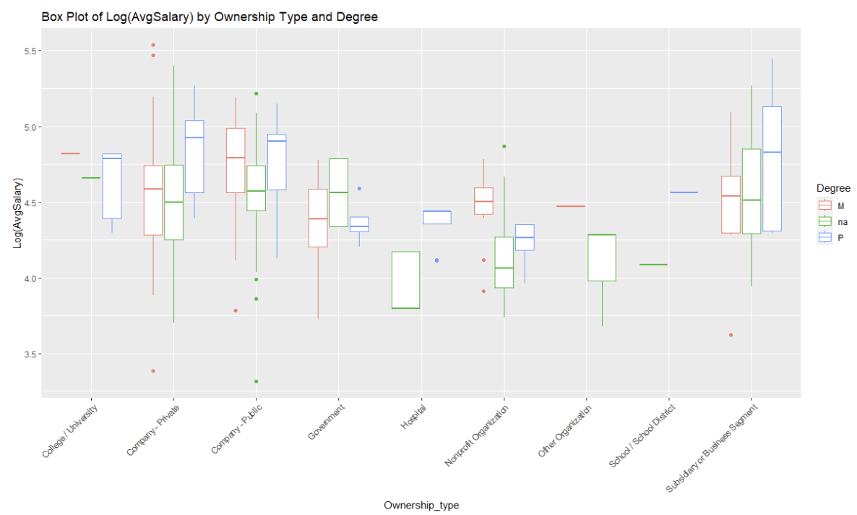
Further EDA Ownership Type & Degree

Slide 65
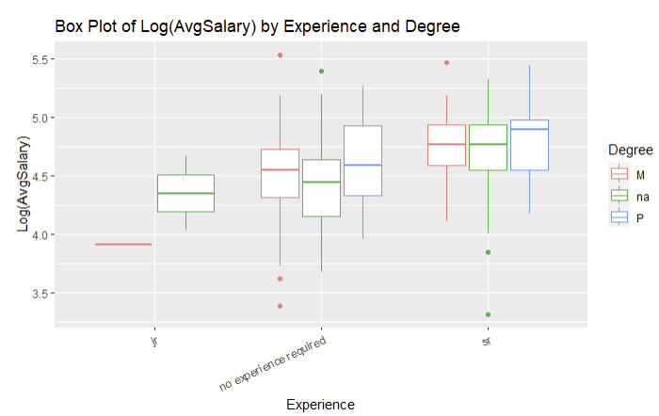
Further EDA Experience & Degree

Slide 66
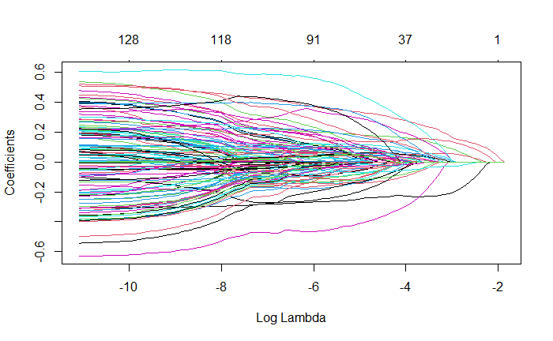



Approach to Complexity:
Interaction Terms
So many predictors!
Practically significant:
Theoretical Rationale
Domain Knowledge
Practicality
Job Title
Experience
Degree

Slide 67
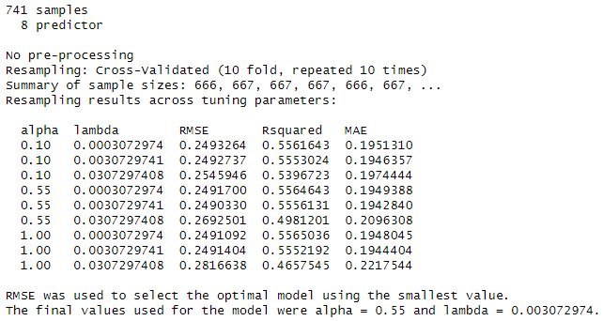
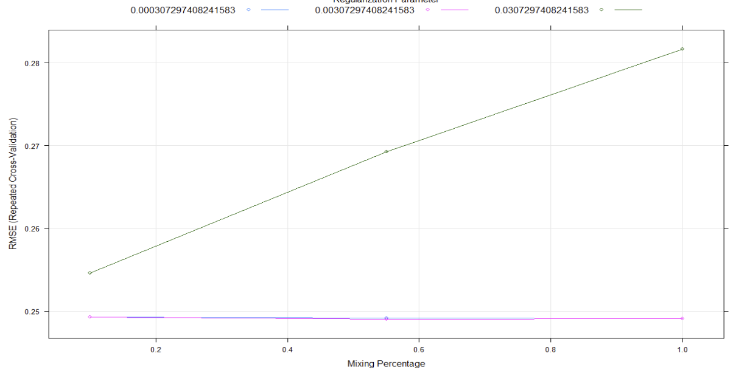
GLMnet:
log(AvgSalary)~ Hourly + Job.Location + Python + Sector + Revenue + sas + mongo + Job_title + Experience + Degree
Notes:
These graphs on the right demonstrate which is giving the least RMSE (different colors represent lambda, mixing percent is the alpha) so we’re saying that .55 has the smallest RMSE

Slide 68
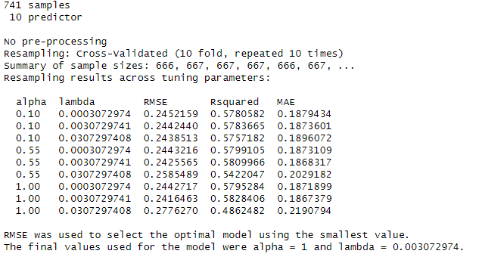
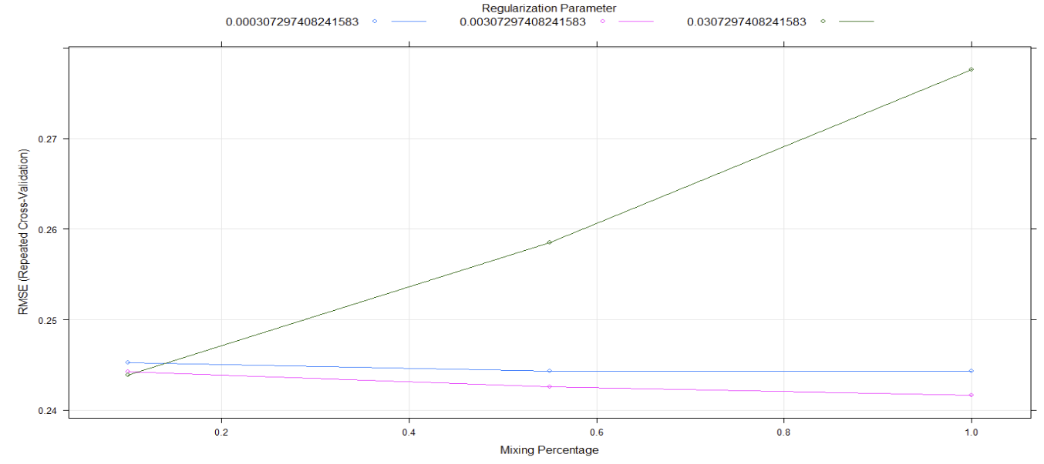
GLMnet:
Log(AvgSalary) & Interaction
log(AvgSalary)~ Hourly + Job.Location + Python + Sector + Revenue + sas + mongo + Job_title * Experience * Degree

Slide 69
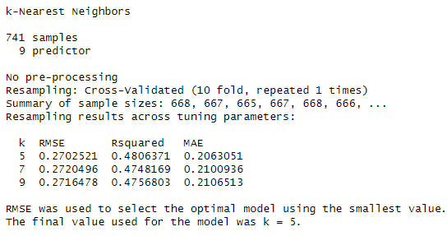
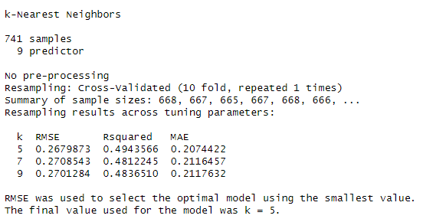
KNN:
log(AvgSalary) Nonparametric
Normal Model
Interaction Model

Slide 70
Model Comparison Performance, Error, and Penalization
Model | Type | Complexity | Alpha / Lambda | K | RMSE | MAE
M3 | GLM | Log(AvgSalary) | Alpha = 0.55 Lambda = 0.003072974 |  | 0.2490330 | 0.1942840
M4 | GLM | Log(AvgSalary) +Interaction | Alpha = 1 Lambda = 0.003072974 |  | 0.2416463 | 0.1867379
M5 | KNN | Log(AvgSalary) |  | K = 5 | 0.2702521 | 0.2063051
M6 | KNN | Log(AvgSalary) +Interaction |  | K = 5 | 0.2679873 | 0.2074422

Slide 71
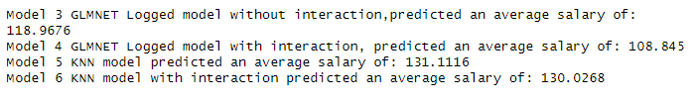
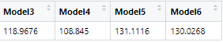

Comparing Model Predictions
Creation of a new dummy row filled with randomized values for each predictor (AvgSalary set to Null)​
Each model was fed the predictors to output an overall prediction for average salary
Overall winner:
GLMnet with interaction!

Slide 72




Conclusion
Objective 2
Future
Objective 1
Scope of Inference

Slide 73
Conclusion
Objective 2
Future
Objective 1
Scope of Inference

Slide 74
Conclusion
Objective 2
Future
Objective 1
Scope of Inference

Slide 75
Conclusion
Objective 2
Future
Objective 1
Scope of Inference

Slide 76




Thank you
Banu Pullaiahnaidu | bpullaiahnaidu@mail.smu.edu
Kyle Kuberski | kkuberski@mail.smu.edu
Mai Dang | maid@mail.smu.edu

